Slide 1
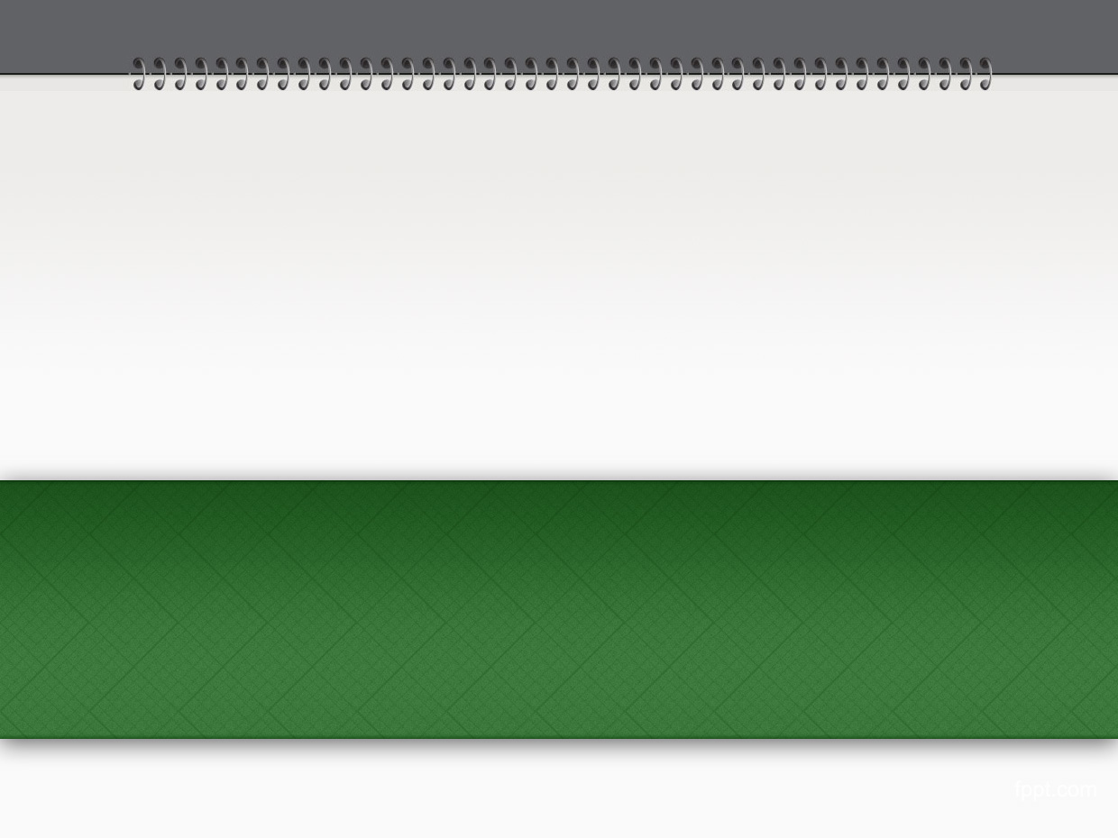
Chapter 1: Ruby programming language
From the book “The Well-Grounded Rubyist”

Slide 2
Overview
In this chapter, we will walk through Ruby programming language. At end of this chapter, you will be asked to make some Ruby scripts.
Repo: https: git@github.com:pingovn/pingo-rails-basic.git
Branch : chapter 1

Slide 3
Ruby
Ruby is a programming language that is easy to learn. Ruby makes less code line than other programming language.
Terms
  Ruby : programming language
  ruby : the interpreter to run a Ruby script
  irb : interactive Ruby shell
For learning Ruby programming language, you could
  Open a terminal
  Type “irb”
  Type ruby commands & see its result

Slide 4
LAB: Walk through examples
Please
  Open terminal
  Execute “irb”
  Type again examples in below link & see what happens
http://pingo.edu.vn/tim-hieu-ve-ruby-qua-cac-vi-du/

Slide 5
Basic syntax
 | Example | Description
Assignment | a = 5 | Assign value 5 to variable a
Print | print “string” | Print a string WITHOUT new line
 | puts “string” | Print a string WITH new line
 | p <array> | Print an array
Conversion | a.to_i | convert to integer
 | a.to_f | convert to float
 | a.to_s | convert to string
Expression | a == b | Compare a is equal b or not
 | if (a) puts “a is false or nil” end | expression is FALSE when a is false or nil
Special value | true | false | boolean value
 | nil | special object, it means “non-object”

Slide 6
Basic syntax
 | Example | Description
Default object | self | refer to default object. Ex: when used in a class, it means the class itself.
Comment | # this code is not executed a = 1 # a is 1
Instance variable | @var
Class variable | @@var
Global | $var
Constant | FIRST_NAME | Always use UPERCASE for constant
Method name | method? | returns true or false
 | method! | can cause exception
Class | String, Array, Hash, Time, Date | upper-case at FIRST letter

Slide 7
Loop
 | Example | Description
Loop | loop { doing something forever } | unfinite loop
 | loop do … break if <<condition>> end | break a loop
 | while <<condition>> end | <<condition>> is judged before doing
 | begin end while <<condition>> | <<condition>> is judged after doing
 | until <<condition>> end
 | begin end <<condition>>
 | <<doing>> until <<condition>>
for I in <<array>> end | for I in [ 1, 2, 3 ] end
 | [ 1, 2, 3 ].each do |i| end
 | 1.upto(1) do |i| end

Slide 8
LAB
Target: practice loop methods
Theory:
  fibonacci array = 1, 1, 2, 3, 5, 8, 13,…
Lab:
  Use loop, for, while, until, each to generate fibonacci[n]

Slide 9
Popular methods
map
  [1, 2, 3 ].map { |i| i.to_s } → [ “1”, “2”, “3” ]
inject(init_value)
  [1, 2, 3].inject(0) { |sum, i| sum+ i} → 6
select
  [1,2,3].select{ |n| n>2 } → [3]

Slide 10
Symbol
Symbol is a popular variable type. Its format is “:var”
Convert to symbol by “to_sym”
Using symbol could reduce memory usage & improve performance
  var[“key”] = value
  var[:key] = value → “:key” is unique key

Slide 11
Use symbol as much as possible
Put below code to a script & execute
  require 'benchmark‘
  str = Benchmark.measure do
  10_000_000.times do
  "test” → using a String
  end
  end.total
  sym = Benchmark.measure do
  10_000_000.times do
  :test → using a Symbol
  end
  end.total
  puts "String: “ + str.to_s
  puts "Symbol: " + sym.to_s
Measure is the method to calculate the running time of block. You will see that symbol takes ½ running time of String.

Slide 12
Gem
RubyGem (or gem) is a library that could be included in an application
RubyGem is most advantage point when using Ruby. It is open source, and there are a lot of developers contribute to develop & maintain.
Install a gem
  gem install <<gem name>>
  During this process, the gem is downloaded from RubyForge (http://www.rubyforge.org/) & put to gem path.
  You could also install a gem from local disk
  gem install <<path/gemfile.gem>>

Slide 13
Rails
Rails is full-stack framework. It is a “gem” as well.
  Stack is a collection of tools or something. Ex: LAMP is popular stack with Linux, Apache, MySQL, PHP. So, PHP is apart of stack.
  Full-stack means that Rails has its own built-in tools to support most of requirements of web development.
As same as other gem, it could be installed by “gem install rails”.
We will investigate more about Rails next chapters ☺

Slide 14
Summary
You learn
  Basic Ruby syntax & popular methods
  Define a method by “def”
  Use block with yield & call_block
  Use initialize, attribute & accessor methods
  Different between String & Symbol, loop methods
  What is a “gem”. rails is also a gem
  …
Tips:
  Ruby is flexible & easy learning programming language. Try to practice Ruby to improving your coding skill.
  Read code of gems if having a chance & learn coding style from ruby gems.
Learning more:
  Ruby book: http://pingo.edu.vn/?p=620
  Tutorial: http://tryruby.org/

